Slide 1
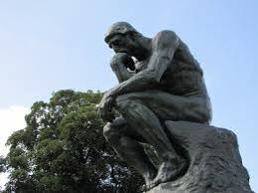
Thinking Strategies

Slide 2
Activate Your Thinking
Define Thinking Strategies.
List ways you have used Thinking Strategies in past classes.
What questions do you still have about Thinking Strategies?
Describe your overall attitude about Thinking Strategies.

Slide 3
Metacognition - What does it mean?
Look up the definition for the prefix “meta” and the definition for the root word “cognition.” Based on their separate meanings, what do you think the word metacognition means?
Share your ideas with your group.
Now, let’s see how close you got …

Slide 4
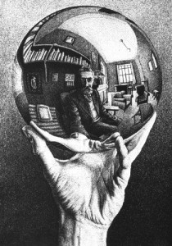
Metacognition: Thinking about my thinking.
“Thinking is the hardest work there is, which is probably the reason why so few engage in it.”
- Henry Ford, industrialist
Sounds Like
I’m thinking …
I’m noticing …
I’m wondering …
I’m seeing …
I’m feeling …

Slide 5
Read the article, “Kids Who Crossed U.S. Border.”
As you read, make notes in the text about your metacognition – how are you processing and comprehending what you read? You may want use the “Sounds Like” stems to help you.
For example, the article says, “They (the students) are also very scared because they don’t have certainty for their future here.” When I process that statement I am feeling sympathy for kids who don’t know if they have a safe future.

Slide 6
Questioning - What does it mean?
Try to come up with a definition for questioning without asking each other any questions as you try to figure it out.
Now, let’s see how close you got …

Slide 7
Questioning: Curiosity about the world around me.
“The important thing is not to stop questioning.”
-Albert Einstein
Sounds Like
I wonder …
What if …
Why …
I don’t understand …
It confused me …
How could …

Slide 8
Refer back to the article.
Create a list of at least 5 questions you have about what you read.
Share your questions with your group.
What are some strategies you could use to find answers to your questions?

Slide 9
Reflection
How did using your metacognition strategies help you process and comprehend the article?
How did questioning clarify your understanding of the article?
Which strategy did you find easier to use/like better? Explain your thinking.

Slide 10
Schema – What does it mean?
The following quote relates to schema …
“Whatever happens is the result of the whole tapestry of one’s life and all the weavings of individual threads from one to another that creates something.”
– Sandra Day O’Connor, Supreme Court Justice
Based on this quote, what do you think schema means? Share your ideas with your group.
Now, let’s see how close you got …

Slide 11
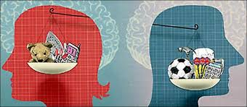
Schema: My background knowledge or experiences.
“When one tugs at a single thing in nature, he finds it attached to the rest of the world. “
- John Muir, conservationist
Sounds Like
That reminds me of …
I’m remembering …
I have a connection to …
I have background for …
I can relate to …

Slide 12
Refer back to the article.
Schema can help you find connections (text-to-self, text-to-text and text-to-world) to the article.
Create a chart in your notebook and use it to record your thinking about schema.
When I Read … | It Reminded Me of …

Slide 13
Determining Importance – What does it mean?
Rank the members of your group in order of importance.
Rank the members of your group in order of importance based on the month they were born. Someone born in January would be the most important, February the second most important, and so on …
It’s a lot easier to determine importance when you know your purpose, right???

Slide 14
Determining Importance:
“In your thirst for knowledge, be sure not to drown in all the information.” -Anthony J. D’Angelo, author
Sounds Like
What’s important here …
What matters to me …
One thing that I should notice …
I want to remember …
It’s interesting that …

Slide 15
Refer back to the article.
Answer the following questions:
1. Why did the author write this article? 2. What does he/she want me to learn? 3. What information is most important for me understanding this article?
4. What information is interesting, but not critical to my understanding?

Slide 16
Reflection
How did using your schema help you connect to the article?
How did determining importance clarify the purpose of the article?
Which strategy did you find easier to use/like better? Explain your thinking.

Slide 17
Inferring – What does it mean?
Read the following paragraph:
Aoccdrnig to rscheearch at Cmabrigde Uinervtisy, it deosn't mttaer in waht oredr the ltteers in a wrod are, the olny iprmoetnt tihng is taht the frist and lsat ltteer be at the rghit pclae. The rset can be a toatl mses and you can sitll raed it wouthit a porbelm. Tihs is bcuseae the huamn mnid deos not raed ervey lteter by istlef, but the wrod as a wlohe.
You used inferences to understand what they said, right? Discuss with your group what inferring means.
Now, let’s see how close you got …

Slide 18
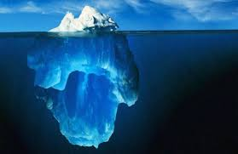
Inferring: Drawing a conclusion based on evidence.
“It’s the stuff between the lines, the empty space between those lines which is most interesting.”
-Robert Carlyle, actor
Sounds Like
Maybe …
Perhaps …
It could be that …
This could mean …

Slide 19
Refer back to the article.
Inferences can help you apply your schema and answer some of your questions.
Go back to your schema chart and add a third column. Record your thinking about inferring.
When I Read … | It Reminded Me of … | I Can Infer That …

Slide 20
Sensory Details – What does it mean?
Sixty seconds. That's how long we're required to stand on our metal circles before the sound of a gong releases us. Step off before the minute is up, and land mines blow your legs off. Sixty seconds to take in the ring of tributes all equidistant from the Cornucopia, a giant golden horn shaped like a cone with a curved tail, the mouth of which is at least twenty feet high, spilling over with the things that will give us life here in the arena. Food, containers of water, weapons, medicine, garments, fire starters. Strewn around the Cornucopia are other supplies, their value decreasing the farther they are from the horn. For instance, only a few steps from my feet lies a three-foot square of plastic. Certainly it could be of some use in a downpour. But there in the mouth, I can see a tent pack that would protect from almost any sort of weather. If I had the guts to go in and fight for it against the other twenty-three tributes. Which I have been instructed not to do.
We're on a flat, open stretch of ground. A plain of hard-packed dirt. Behind the tributes across from me, I can see nothing, indicating either a steep downward slope or even a cliff. To my right lies a lake. To my left and back, sparse piney woods. This is where Haymitch would want me to go. Immediately.
What did you do in your mind as you read this passage?

Slide 21
Sensory Details: Creating a picture, sound, texture, or smell in my mind.
“The true seeing is within.”
-George Eliot, novelist
Sounds Like
I’m picturing …
I can imagine …
I can feel …
I can see …
I can smell …
I can taste …
I can hear …

Slide 22
Refer back to the article.
Using your senses will bring the reading to life and strengthen your comprehension.
Create a chart in your notebook to record your thinking about sensory details.
Word or Phrase | I saw/heard/felt … | Deepened my understanding because …

Slide 23
Reflection
How did using inferences clarify your understanding of the article?
How did using your senses help you understand the article?
Which strategy did you find easier to use/like better? Explain your thinking.

Slide 24
Synthesis – What does it mean?
On your own, write a definition for the word synthesis.
Share your definition with your group.
Together, create a definition based on your individual responses.
Now, let’s see how close you got …

Slide 25
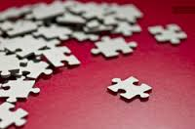
Synthesis: The evolution of my thoughts.
“A mind stretched to a new idea never goes back to its original dimensions.”
-Oliver Wendall Holmes, jurist
Sounds Like
Now I understand why …
I’m changing my mind about …
I used to think _____, now I think _____...
My new thinking is …

Slide 26
Refer back to the article.
If you are really processing and comprehending what you read, then your thinking will change as you synthesize.
Complete these stems about the article:
“First I was thinking …”
“Then I was thinking …”
“Now I think …”

Slide 27
Final Thoughts
Has your understanding of the definition of Thinking Strategies changed? Explain.
List ways you will use Thinking Strategies in your classes this year.
What questions do you still have about Thinking Strategies?
Has your overall attitude about Thinking Strategies changed? Explain why or why not.

