Slide 1
Types of Claims
Claims typically fall into one of four categories… For each of the following pictures, try to determine a category that would fit the claim.

Slide 2
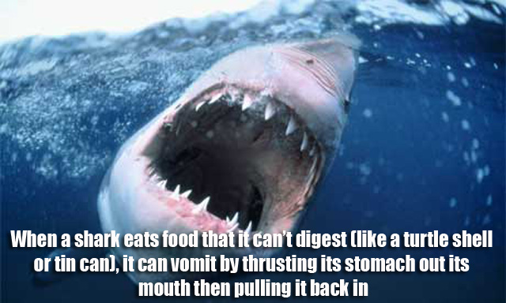

Slide 3
