Slide 1
Informational Unit Test Review
100 points

Slide 2
Standards covered:
Resources Needed
Informational Unit Pages
8.RI.2 Determine a central idea of a text and analyze its development over the course of the text, including its relationship to supporting ideas; provide an objective summary of the text.
8.RI.6 Determine an author’s point of view or purpose in a text and analyze how the author acknowledges and responds to conflicting evidence or viewpoints.

Slide 3
Summary Plan
Resources Needed
Summary Plan notes, handouts, Summary Plan homework
Know the steps and how to apply them.

Slide 4
Purposes for Writing
Resources Needed
Definitions of types of purposes and Purpose Challenge packets
Know the types and how to determine an author’s purpose.

Slide 5
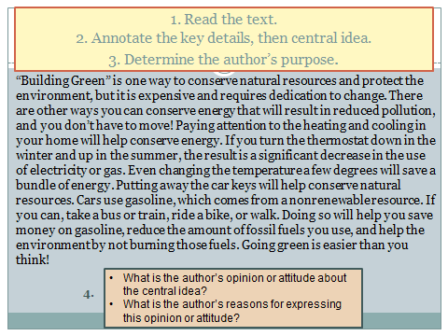
Parts of an Argument
Resources Needed
Definitions of the parts of an argument and practice packet
Know the parts of an argument, how to determine author’s perspective, how to identify the claim and find evidence.

