Slide 1
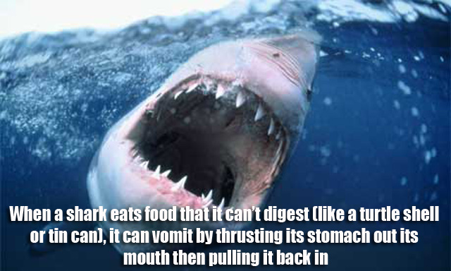
Which type of claim does this represent?
Claims of definition or fact B. Claims of cause and effect
C. Claims about solutions or policies D. Claims about value

Slide 2
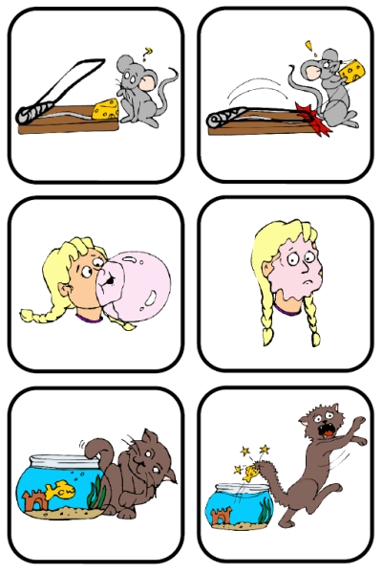
Which type of claim does this represent?
Claims of definition or fact
B. Claims of cause and effect
C. Claims about solutions or policies
D. Claims about value

Slide 3
Which type of claim does this represent?
Claims of definition or fact B. Claims of cause and effect
C. Claims about solutions or policies? D. Claims about value

Slide 4
Which type of claim does this represent?
Claims of definition or fact
B. Claims of cause and effect
C. Claims about solutions or policies
D. Claims about value

