Slide 1
Comprehension & Communication Skills Unit
Grammar Warm-ups

Slide 2
1. How many times do you see quotation marks being used? 2. For what different purposes are they being used? 3. Read the orange text carefully, why does one sentence use quotation marks and one does not?
Warm-up # 1 9/29/14
“What Lies Beneath George Washington’s Portrait?”
One of the most famous portraits of George Washington will soon get a face-lift of sorts. For the first time in decades, the painting known as the "Lansdowne" portrait will be closely examined and cleaned as part of an extensive conservation project. Experts will use high-tech tools to peel away the effects of time, making it look much as it did when it was originally painted.
The conservation project, aimed at restoring the painting to its original appearance, will take some time. Work will begin in 2016 to delicately remove a yellowed varnish that has built up on the surface. This will make it possible to see the original colors and details intended by the artist. The project is expected to take 18 months.
Brandon Brame Fortune, who is chief curator at the Smithsonian, said the painting needs some touching up. "We want to be sure our visitors are seeing it looking its absolute best," he said.
The painting is in good condition but does have problems, including paint losses in Washington's black coat, said Cindy Lou Molnar, the museum's head of conservation. The biggest problem, though, is the heavy yellow varnish that makes it hard to see details in the painting.
"It will take me quite a while to figure out what it will take to safely remove the yellow resinous varnish and not disturb the actual paint surface," Molnar said.
Notes:
Used with thesis station lessons

Slide 3
1. What new use of quotation marks do you notice? 2. Write down an example of a direct quote and an indirect quote. What is the difference between the two?
Warm-up # 2 9/30/14
“Play ball! Little League World Series Stars Two Girls”
More than 60 years ago, Kathryn "Tubby" Johnston Massar cut off her braids, tucked her hair under her cap and disguised herself to become the first girl to play Little League baseball. She's delighted today to see two girls in the Little League World Series.
"It's truly amazing. I'm very happy to see girls playing," said Massar, 78, of Yuba City, California.
On Friday, Philadelphia's Mo'ne Davis and Canada's Emma March became the 17th and 18th girls to ever play in the tournament. It is only the third time in the event's 68-year history that two girls are playing in the same series.
Davis pitched as Philadelphia beat Nashville 4-0. She had eight strikeouts, didn't walk a batter and gave up just two hits.
Davis, who got louder cheers than any other player during introductions, said she noticed plenty of girls younger than her in the audience. Fans applauded even louder when Davis struck out the final batter. The out made her the first girl to throw a shutout in Little League World Series history.
"It's very unreal. I never thought at the age of 13, I would be a role model," Davis said. "Hopefully, more girls play Little League."
Notes:
Used with thesis station lessons

Slide 4
1. What are the uses for quotation marks we have learned about so far? 2. What two new uses of quotation marks do you notice? Why are they being used? 3. There is a mistake involving the quotation marks in the highlighted sentence. What is it?
Warm-up # 3 10/1/14
“Disney’s Small World Ride Turns Fifty”
1963, Alice Davis was working as a seamstress, stitching ladies underwear in the downtown Los Angeles garment district. One day she got a call: Walt Disney wanted to see her.
When she got to Disney’s office, the theme park pioneer told her he was planning a new ride for the 1964 New York World’s Fair. He promised the ride would bring joy “to every child from 1 to 100”.
Davis designed the costumes for the ride — It’s a Small World. Now, 50 years later, it’s one of Disneyland’s most popular attractions. Its boats have carried 290 million visitors, or about 111,000 a week for half a century.
Ride Small World and you’ll be taking a slow-moving and peaceful boat ride through the “countries” of the world. Each room features dolls in traditional garb dancing and singing the title song:
“It’s a world of laughter / A world of tears / It’s a world of hopes / And a world of fears / There’s so much that we share / That it’s time we’re aware / It’s a small world after all …”
Notes:
Used with thesis station lessons

Slide 5
1. What is the mistake on this magazine cover? 2. How does it affect the meaning of the sentence? 3. Rewrite it correctly.
Warm-up #4 10/20/14
Notes:
Used with connotative/denotative lessons

Slide 6
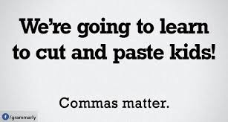
1. What are the mistakes in these sentences? 2. How do they affect the meaning of each sentence? 3. Rewrite them correctly.
Warm-up #5 10/23/14
Notes:
Used with connotative/denotative lessons

Slide 7
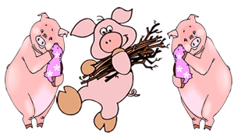
All summer long, they roamed through the woods and over the plains, playing games and having fun. None were happier than the three little pigs, and they easily made friends with everyone. Wherever they went, they were given a warm welcome, but as summer drew to a close, they realized that all drifting back to their usual jobs, and preparing for winter. Autumn came and it began to rain. The three little pigs started to feel they needed a real home. Sadly, they knew that the fun was over now and they must set to work like the others, or they'd be left in the cold and rain, with no roof over their heads.
Warm-up #6 11/5/14
Look at the highlighted parts of the text. Why does the writer use a comma after these phrases?
How would the writing be different without the phrases? Why are they important?
Notes:
Used with POV lessons
Intro. Phrase
Establish context and transition

Slide 8
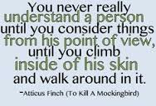
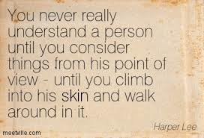
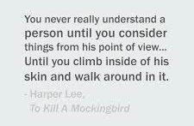
Warm-up #7 11/6/14
-
What do you notice about the punctuation in these three versions of a quote from To Kill a Mockingbird?
Which version do you think is the strongest writing? Explain.
Notes:
Used with POV lessons
1. One uses em dash, one a comma and one ellipses

