Slide 1
Figurative & Literal
Warm-ups

Slide 2
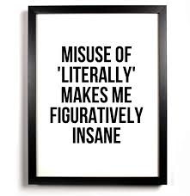
Warm-up #1 10/27/14
What is the difference between figurative and literal language?
In what type of writing would you expect to find figurative language? What about literal language? Explain your answer.

Slide 3
Warm-up #2 10/28/14
Define literal and figurative language and give an example of each.
List the types of figurative language.
Choose two types of figurative language and give an example of each.

Slide 4
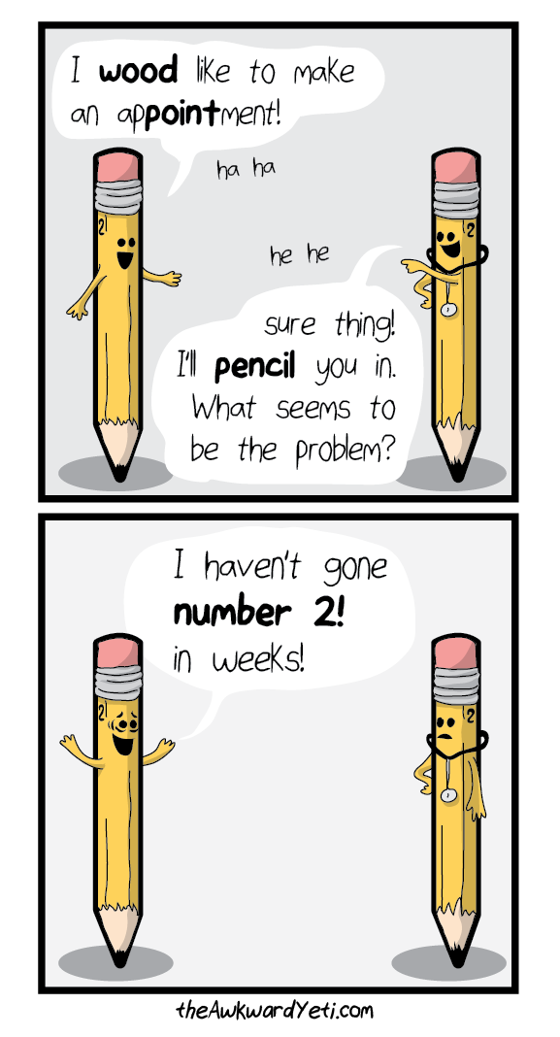
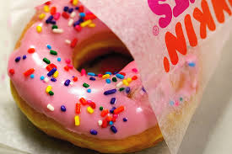
Warm-up #3 10/29/14
What type of figurative language is being used in the cartoon? Explain.
What type of figurative language does the picture represent? Explain.

Slide 5
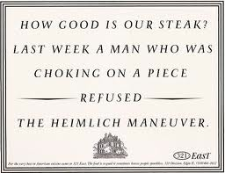
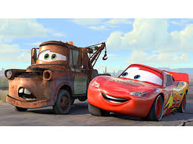
Warm-up #4 10/30/14
What type of figurative language does this ad use? Explain.
What type of figurative language do Mater and Lightning McQueen represent? Explain.

