Slide 1
Compare & Contrast
Warm-ups

Slide 2
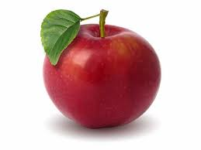
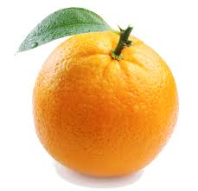
Warm-up #1 10/13/14
How are apples and oranges the same? How are they different?
What are some reasons why you would compare apples and oranges?
You are trying to persuade a friend to eat an apple instead of an orange – what arguments could you use?

Slide 3
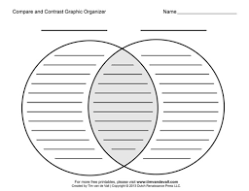
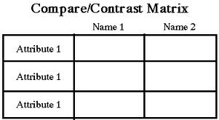
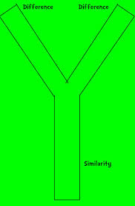
Warm-up #2 10/14/14
Define graphic organizers.
What are some graphic organizers you could use to compare and contrast?
Use a graphic organizer of your choice to compare and contrast one of the following items (or choose your own). Remember to identify which features you will be using.
6th Grade vs. 8th Grade
College basketball vs. the NBA
Papa John’s vs. Snappy Tomato
Book vs. Movie
Country vs. Rap

Slide 4
Warm-up #3 10/15/14
Imagine you are at the store trying to decide on a snack. Go through the compare and contrast process.
What two snacks are you trying to choose between?
What features of each snack will you be comparing and contrasting?
Complete a graphic organizer (Venn diagram, compare/contrast chart, or choose your own).

Slide 5
Warm-up #4 10/16/14
Write a paragraph explaining the snack you chose in yesterday’s warm-up. Include details from the compare and contrast process you used to make your decision.

